Slide 1
The First Step in Test Automation of Web Applications
Victoria Elizaryan, Senior Test Automation Engineer
Notes:
Hi, My name is Viktoriya and I am working as a Senior QA Automation Engineer.
I started my way from QA manual Engineer and then I became QA Automation Engineer. I have a lot of experience in QA Automation
Many qa Engineers think that becoming qa automation is really hard.
But that's not really true. I will tell you about 5 steps how to do it easier
I'll tell you five steps how to become a QA Automation Engineer

Slide 2
0. Basic understanding of JS
Web application
DOM elements
Engine for linking Desktop machine and Web application
Autotest Runner
Page Object architecture
Optional steps:
CI
Report
© 2022 Quantori. Custom Software Solutions
Steps to become Test Automation Engineer
Notes:
0. Null step is JS code.
It is not an important step, you should only understand basic things like: what is a variable, cycle, method.
Only common things. we will talk more about this step later

Slide 3
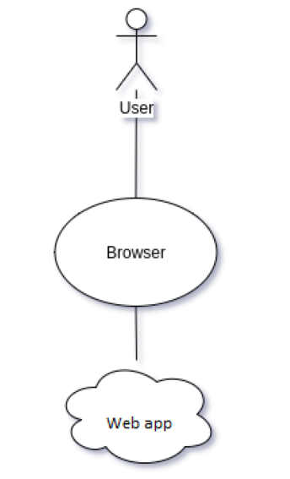

A web application (or web app) is application software that runs on a web browser
All web applications open in the web browser
© 2022 Quantori. Custom Software Solutions
Step 1. Web Application
Notes:
Let's start with the first step. What is a web application? A web application (or web app) is application software that runs on a web browser.
It doesn't matter for us how this application was built and run, what language backend and frontend is using.
Only one important thing that you need to understand is.
All web applications open in the web browser. Chrome safari Opera and other
You as a user work with the web browser and web Browser works with your web application.
Let move on and I will tell you about

Slide 4
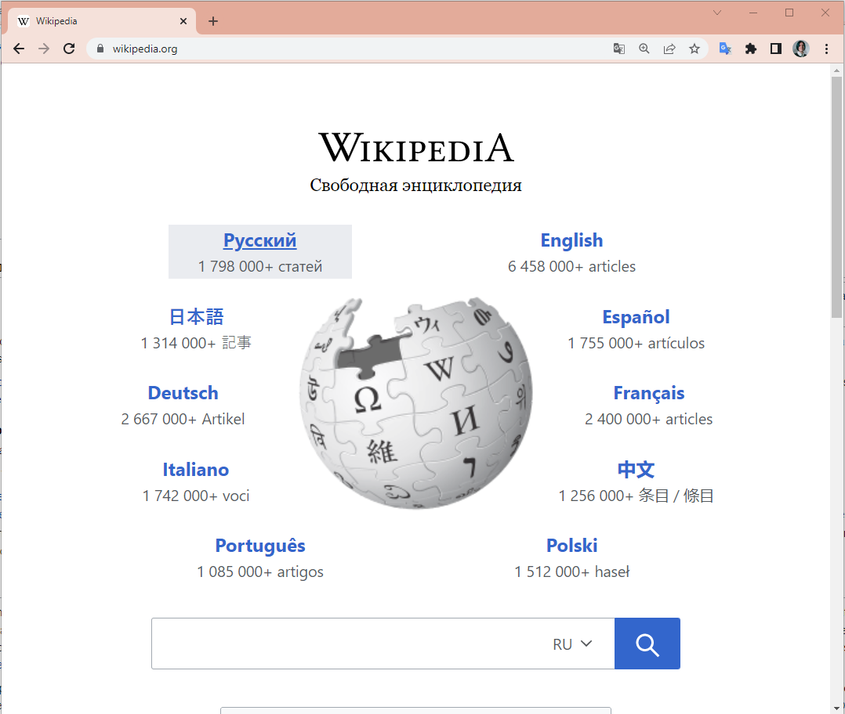
© 2022 Quantori. Custom Software Solutions
Step 1. Web Application
Enter some text to the search field
Click on the search button or link
Check some text on the page
Notes:
For example open https://www.wikipedia.org/ web cite.
wikipedia is a web application And I used chrome browser for work with this application.
Now I see one page of this application.
I as a user I can do three thing with this page:
Enter some text to the search field
click on the search button
check some text on the page
That's actually all.
Now let's try to write a js script for these actions.
Put some text to the search field and click the search button.
To do this, we must understand what DOM elements are.

Slide 5
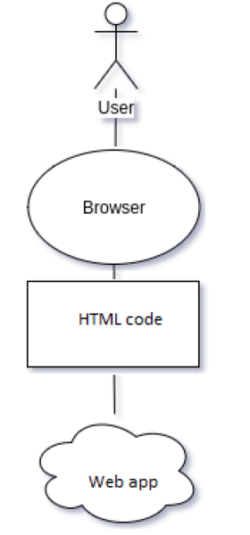
Our web application gives us the HTML code ->
Our web browser takes this code and gives us the DOM Elements ->
DOM is the document object model that the browser creates based on the HTML code ->
We use the DOM Elements to select a specific object on this page
DOM Elements are: buttons, input fields, text, pictures and many others
The whole web page is rendered as objects of DOM
© 2022 Quantori. Custom Software Solutions
Step 2. DOM elements
Notes:
And we go to the 2 steps DOM elements
They are all elements of the DOM

Slide 6
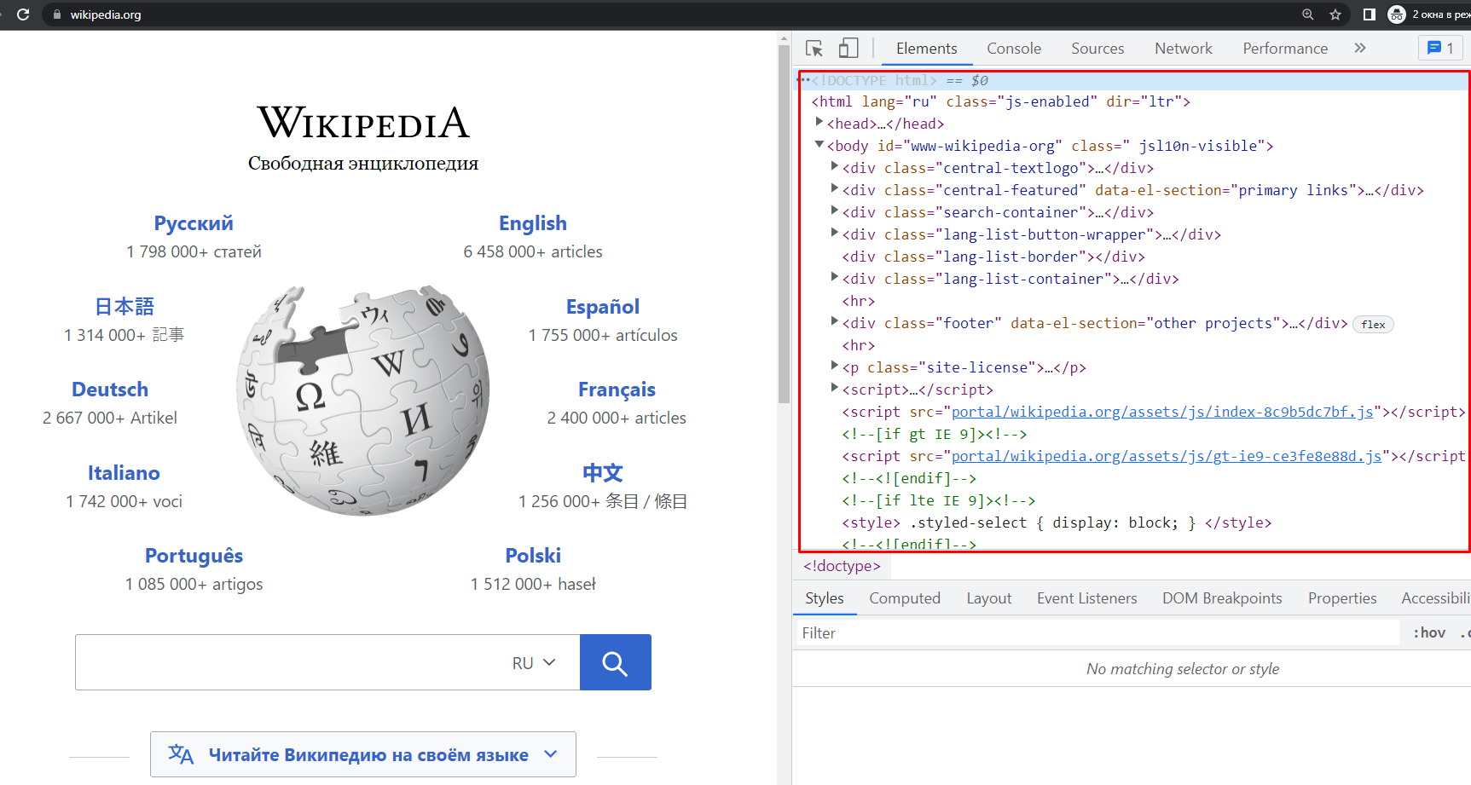
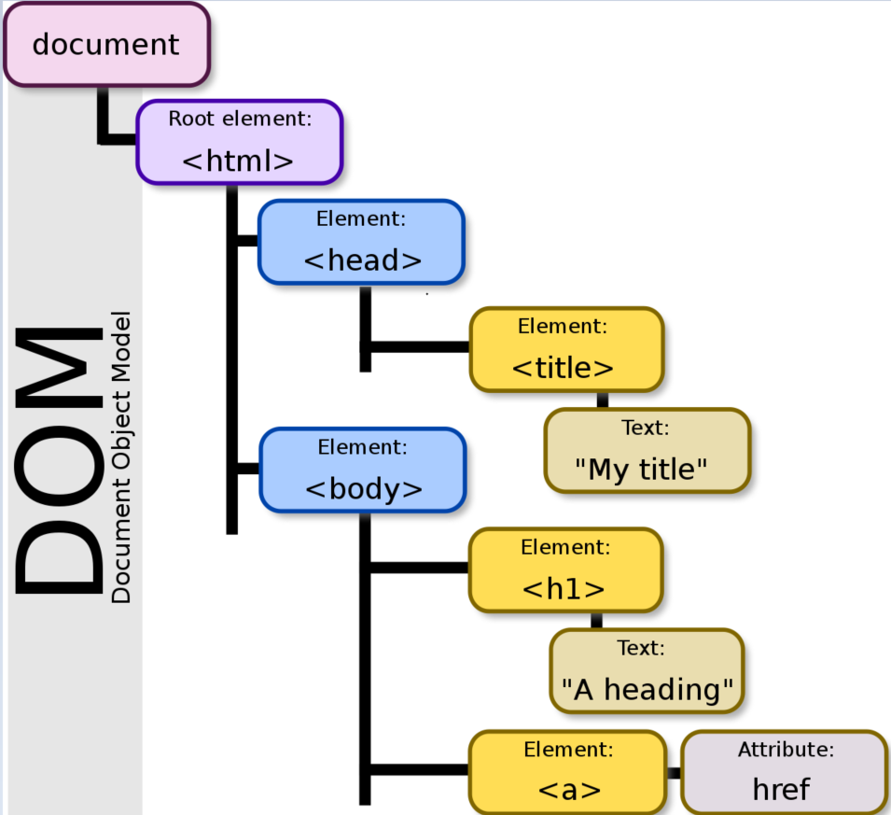
© 2022 Quantori. Custom Software Solutions
Step 2. DOM elements
Notes:
Come back to https://www.wikipedia.org/ page again.
press key F12 - on the right side will open the DevTools console. This tools will help us to work with web application
Click on the Elements tab and we can see DOM elements for this page on the right side

Slide 7
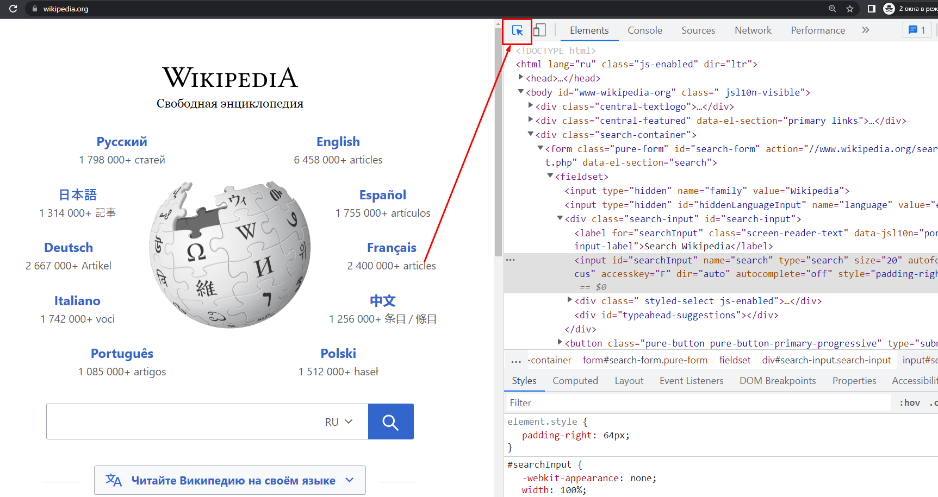
© 2022 Quantori. Custom Software Solutions
Step 2. DOM elements
Notes:
With this button we can select object on this page and we will see it dom element on the devTools
Remember: We want to enter text into an input field and click a search button.

Slide 8
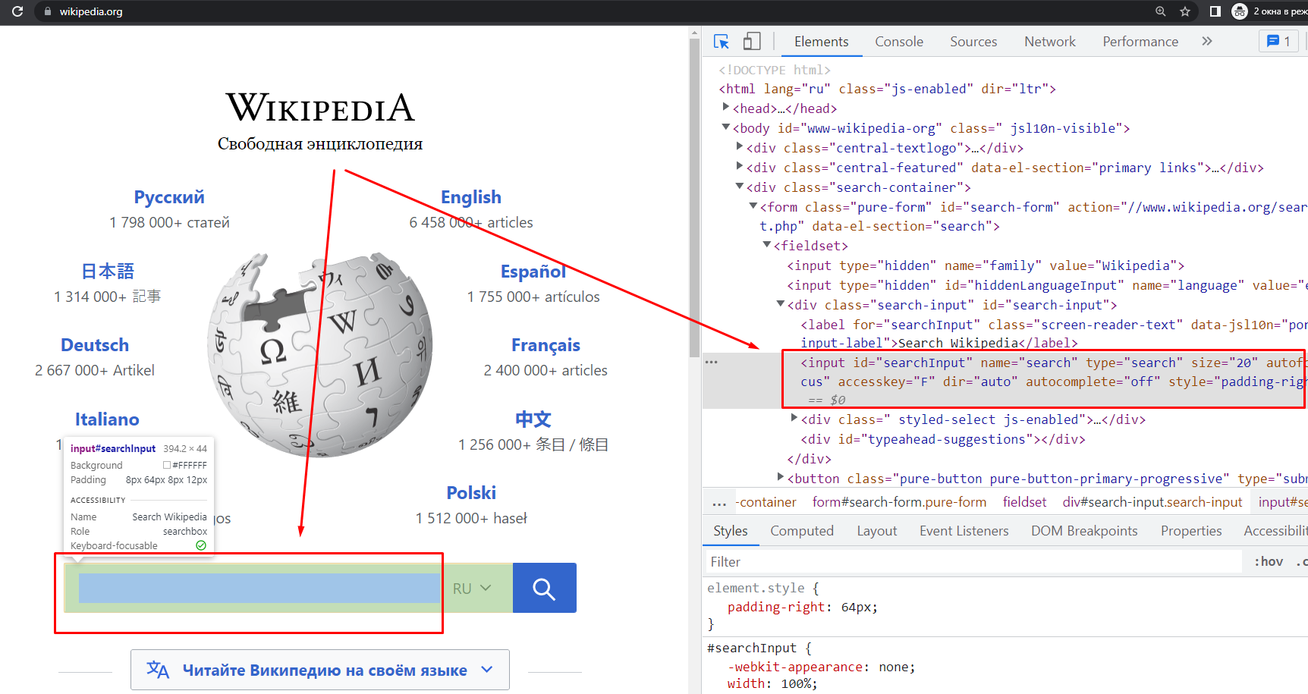
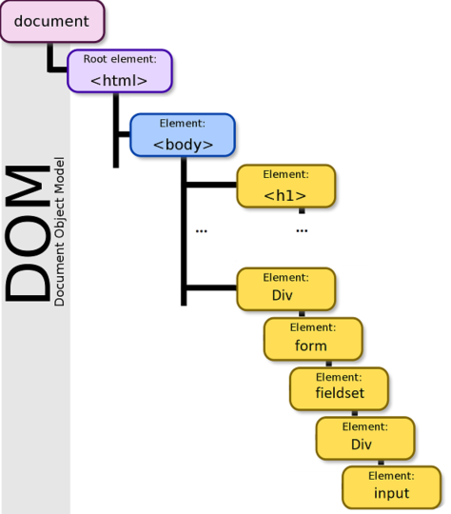
© 2022 Quantori. Custom Software Solutions
Step 2. DOM elements
Notes:
we see this element on the right side
Now we need to find the locator of this element.
What is a locator?

Slide 9
© 2022 Quantori. Custom Software Solutions
Step 2. DOM elements
A locator is a way to identify a web element.
The way have we differentiate one object from another.
How to select locators?
Check out this article on Habr https://habr.com/ru/company/skyeng/blog/588282/
Practice here https://flukeout.github.io/ and https://topswagcode.com/xpath/
Notes:
If you want to know more about locators you can read the article below.
Now we will find the locator for search field

Slide 10
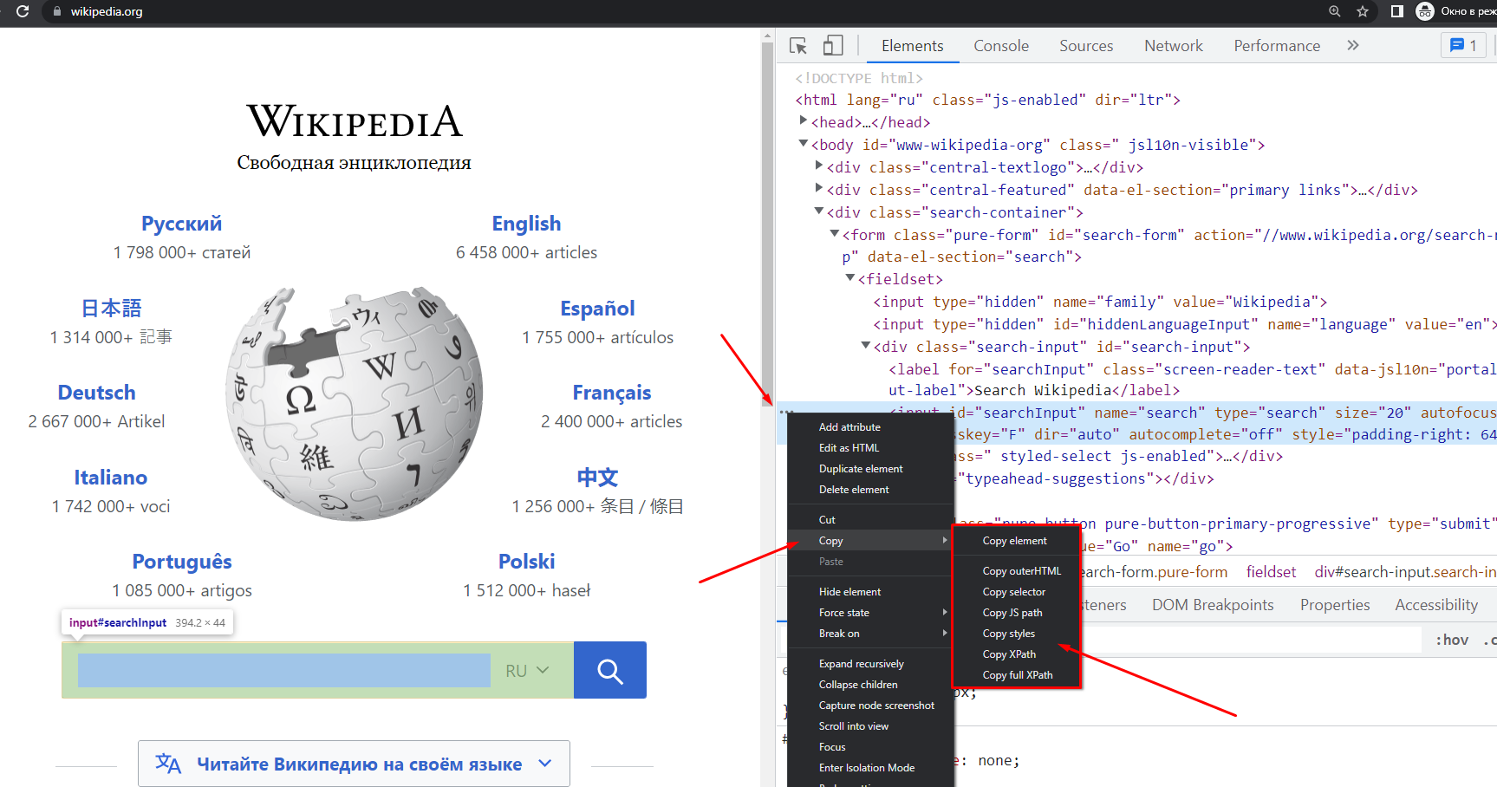
© 2022 Quantori. Custom Software Solutions
Step 2. DOM elements
Notes:
Come back to our example, click 3 dots and select Copy -> then copy JS path

Slide 11
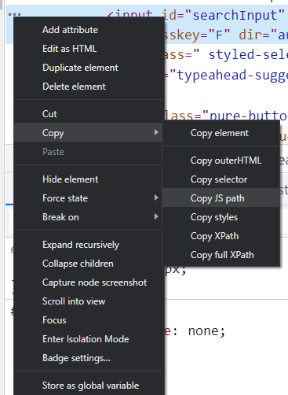
© 2022 Quantori. Custom Software Solutions
Step 2. DOM elements
document.querySelector("#searchInput") - js code
"#searchInput" - locator
Notes:
If we paste this text we will see js code - this code will selects a search field on the page.
Into this code we can see locator for search button object

Slide 12
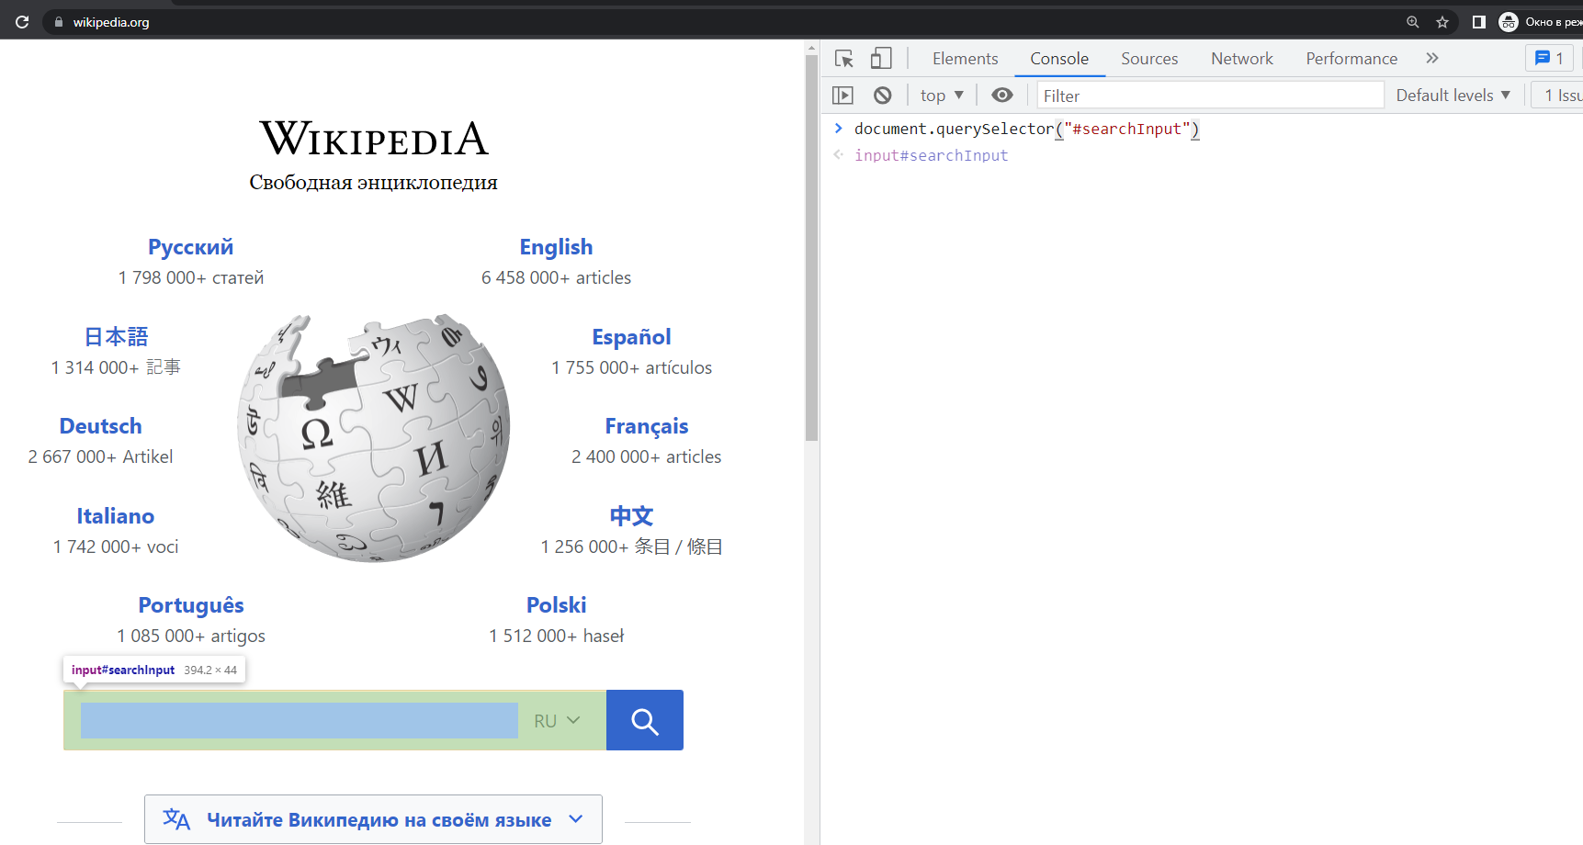
© 2022 Quantori. Custom Software Solutions
Step 2. DOM elements
Notes:
Then we go to the console tab (into dev tools)
This tab allows us to run a js code into application context
If we paste our code on the right side -> we will see the selected input field on the left side.
Let's insert text into this field

Slide 13
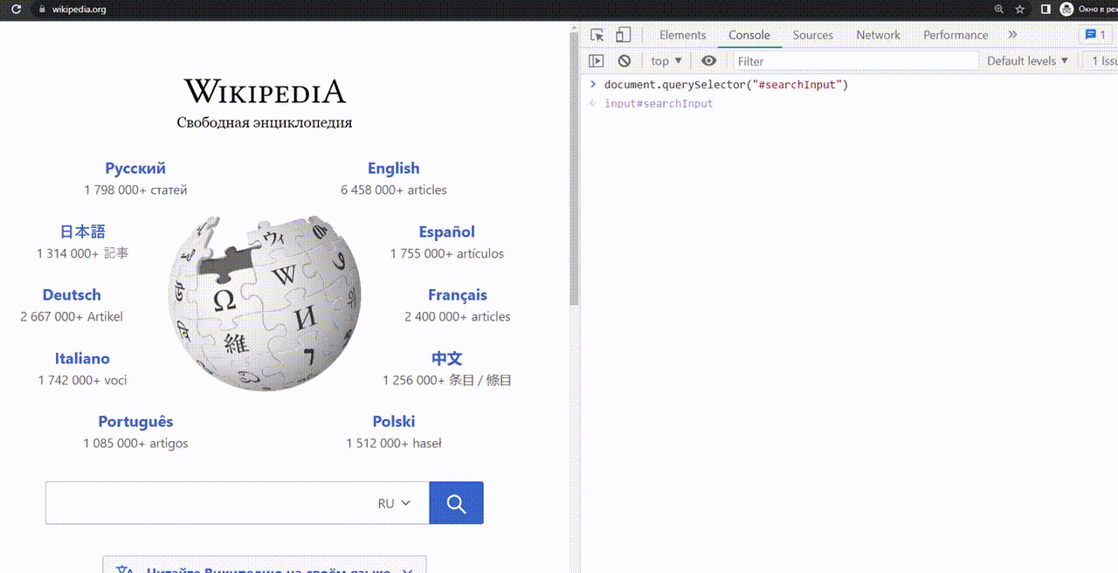
© 2022 Quantori. Custom Software Solutions
Step 2. DOM elements
document.querySelector("#searchInput").value = 'test';
Notes:
Let's insert text into the search field with this command.
WE used this code and add some value for it
We use this command to fill search field

Slide 14
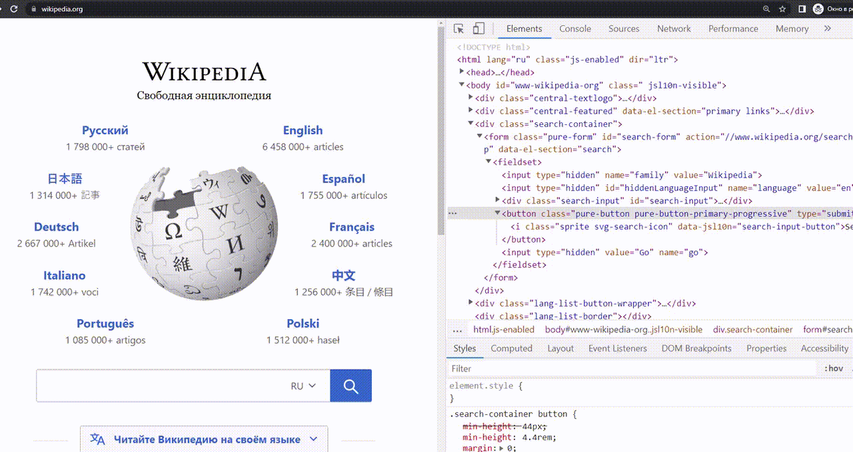
© 2022 Quantori. Custom Software Solutions
Step 2. DOM elements
document.querySelector("#search-form > fieldset > button").click();
Notes:
Now let's repeat our actions for the search button and click on it.
Click 3 dots and select Copy -> then copy JS path. Then past our value into console and add “dot click” command
It is work

Slide 15
© 2022 Quantori. Custom Software Solutions
Step 2. DOM elements
function test() {
document.querySelector("#searchInput").value = 'test';
document.querySelector("#search-form > fieldset > button").click();
}
test();
Notes:
Now combine our two lines into one test.
We add a function and call this function tests.
Put two line into this function
This is really all, our first test is ready

Slide 16
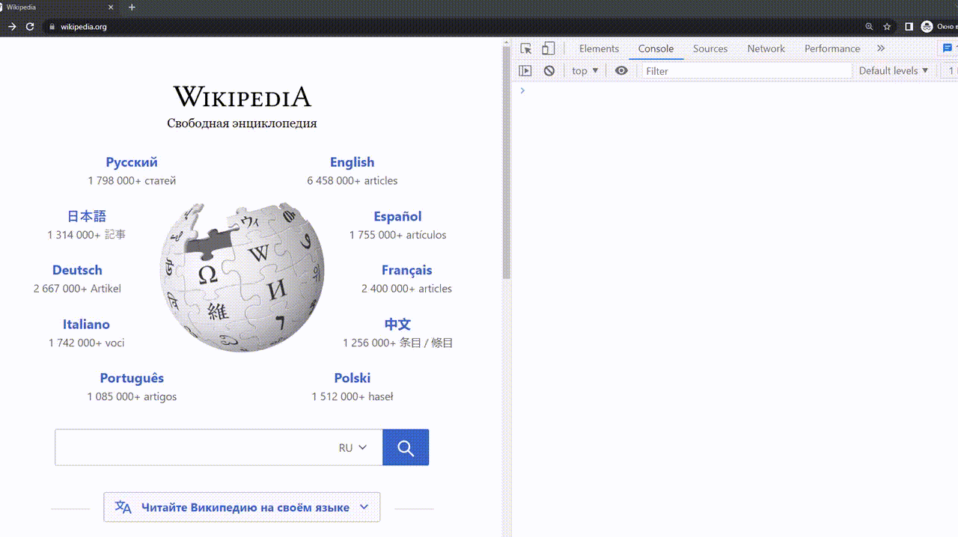
© 2022 Quantori. Custom Software Solutions
Step 2. DOM elements
Notes:
Now run our test. Add our code into console.
You see it works. This is our first test.
now we will transfer our test from the browser to the computer

Slide 17
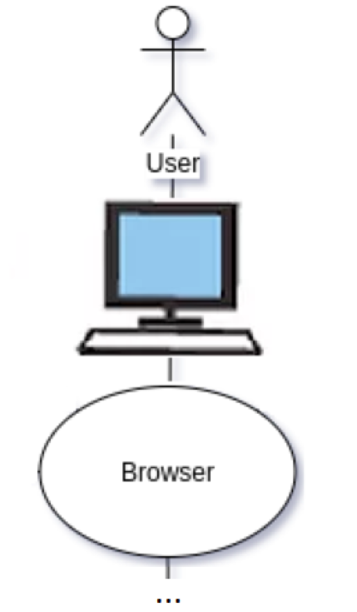
If you want to run js code on your computer we should set Node.js https://nodejs.org/en/
After we do it we can create a file with format .js and run it like: node test.js on the command line.
Let's do that!
© 2022 Quantori. Custom Software Solutions
Step 0. JS
Notes:
And we go to null steps

Slide 18
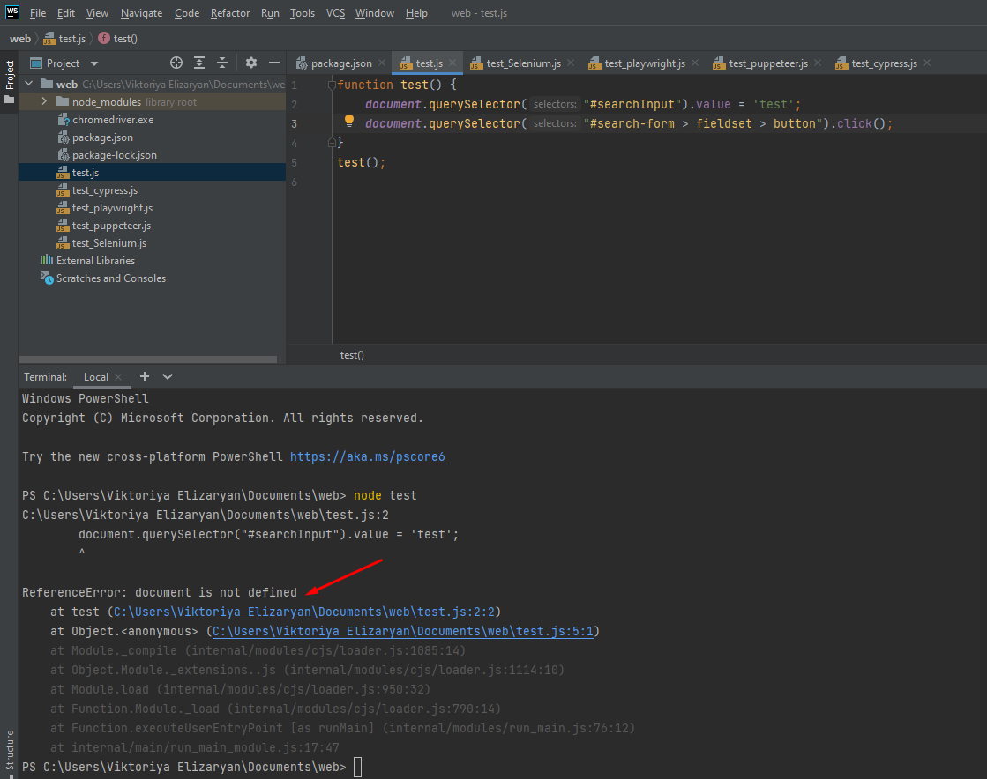
© 2022 Quantori. Custom Software Solutions
Step 0. JS
Run: node test and see error:
ReferenceError:
document is not defined
Notes:
We create a test.js file and put our code into this file.
Then we run this file with command node test.js
We see error ReferenceError: document is not defined.
We have this error because our computer doesn't know anything about DOM elements and nothing about our website.
Right now We run our code in the computer context.
If we want to connect a computer with a web application, we should use ENGINES.

Slide 19
There are different ways to link your code with a web application in a browser
4 most popular engines:
Selenium
Puppeteer
Cypress
Playwright
The choice of engine is a very important part of your automation project because this part can not be changed.
© 2022 Quantori. Custom Software Solutions
Step 3. Engines
Notes:
The choice of engine is a very important part of your automation project because this part can be changed.

Slide 20
Selenium - exists since 2004. Selenium WebDriver, browser driver (ChromeDriver, GeckoDriver, EdgeDriver , SafariDriver) and web browser.
Pros: supports all browsers and has MANY useful tutorial
Cons: the slowest and less stable
Puppeteer - exists since 2012. Works with the web browser using the DevTools protocol.
Pros: the fastest
Cons: works only with Chrome-family browsers
Cypress - exists since 2015. Doesn't run a code outside the browser as WebDriver. Runs your code inside the browser, it executes your test code and the code of the web application together.
Pros: network interception and imitation of network requests
Cons: the slowest
Playwright - exists since 2020. It also works with browser driver, but uses an isolated environment, the so-called browser context.
Pros: supports Chrome-family browsers, Firefox, WebKit.
Cons: very young, there are some bugs.
© 2022 Quantori. Custom Software Solutions
Step 3. Engines

Slide 21
We are using Node.js to install these engines:
Selenium: npm i -D selenium-webdriver + manually download chromedriver or other browser driver
Puppeteer: npm i -D puppeteer
Cypress: npm i -D cypress
Playwright: npm i -D playwright
© 2022 Quantori. Custom Software Solutions
Step 3. Engines
Notes:
Let's install them on our computer. For this we will use these commands

Slide 22
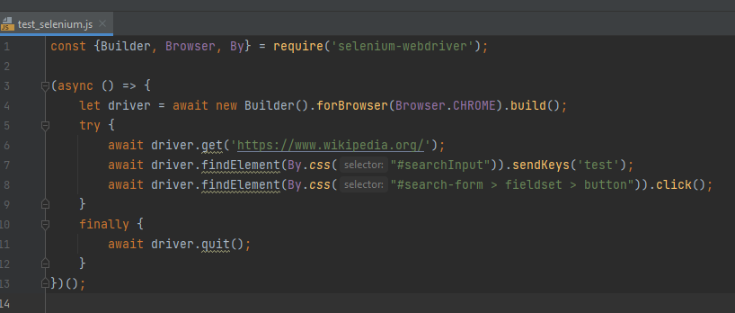
© 2022 Quantori. Custom Software Solutions
Step 3. Engines. Selenium
Notes:
We add new link to selenium-webdriver
After that we can use it.
This is the working code. If we run it we will see this:

Slide 23
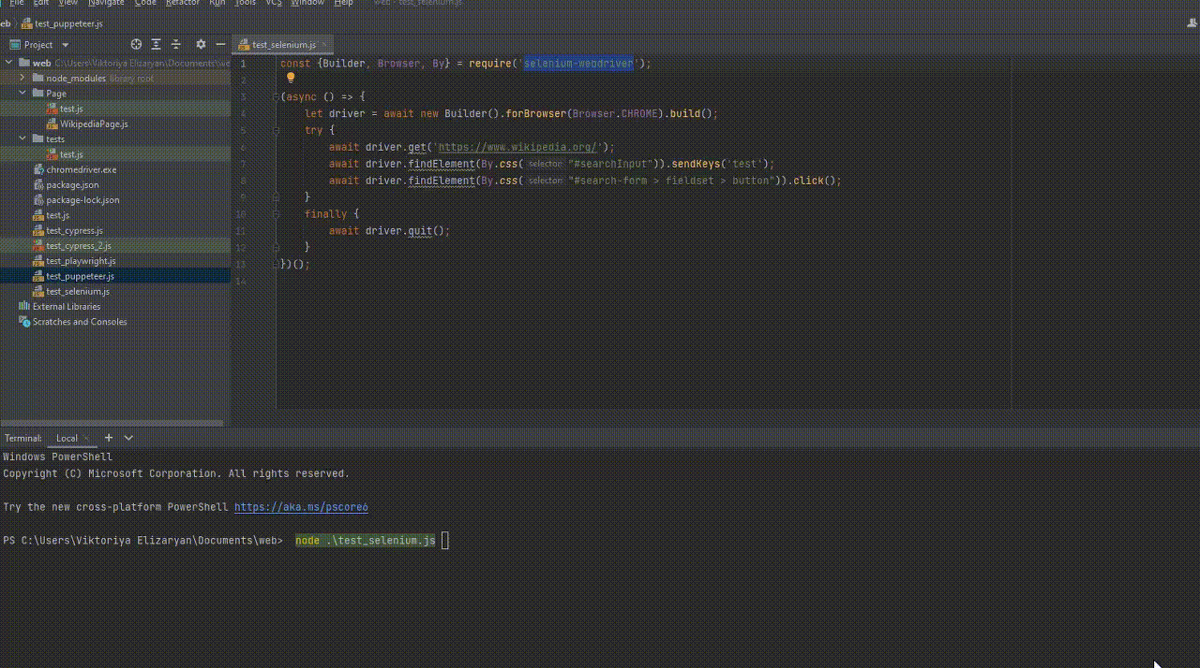
© 2022 Quantori. Custom Software Solutions
Step 3. Engines. Selenium

Slide 24
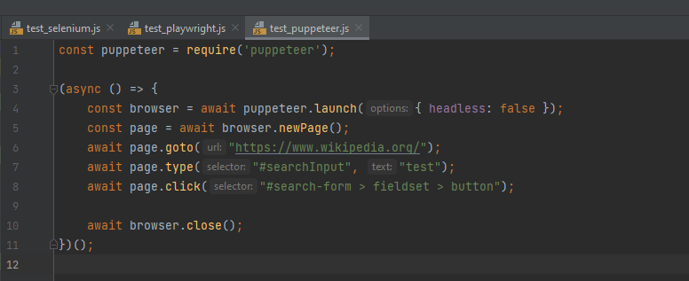
© 2022 Quantori. Custom Software Solutions
Step 3. Engines. Puppeteer

Slide 25
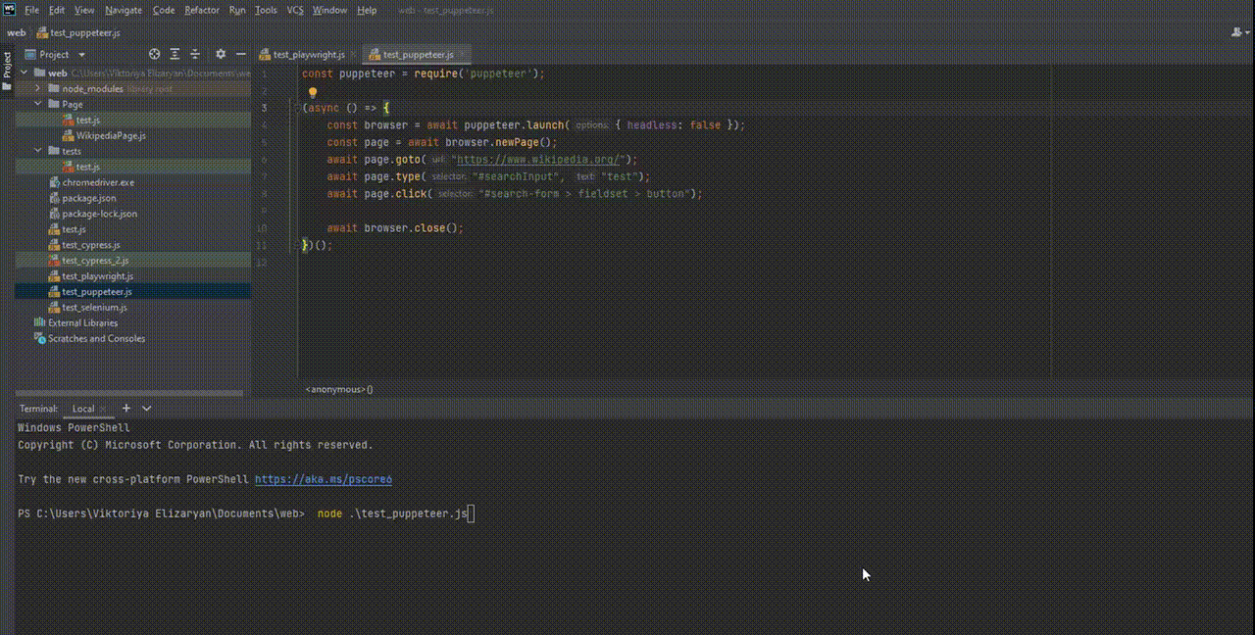
© 2022 Quantori. Custom Software Solutions
Step 3. Engines. Puppeteer

Slide 26
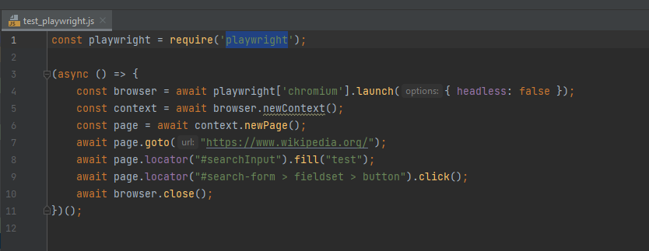
© 2022 Quantori. Custom Software Solutions
Step 3. Engines. Playwright

Slide 27
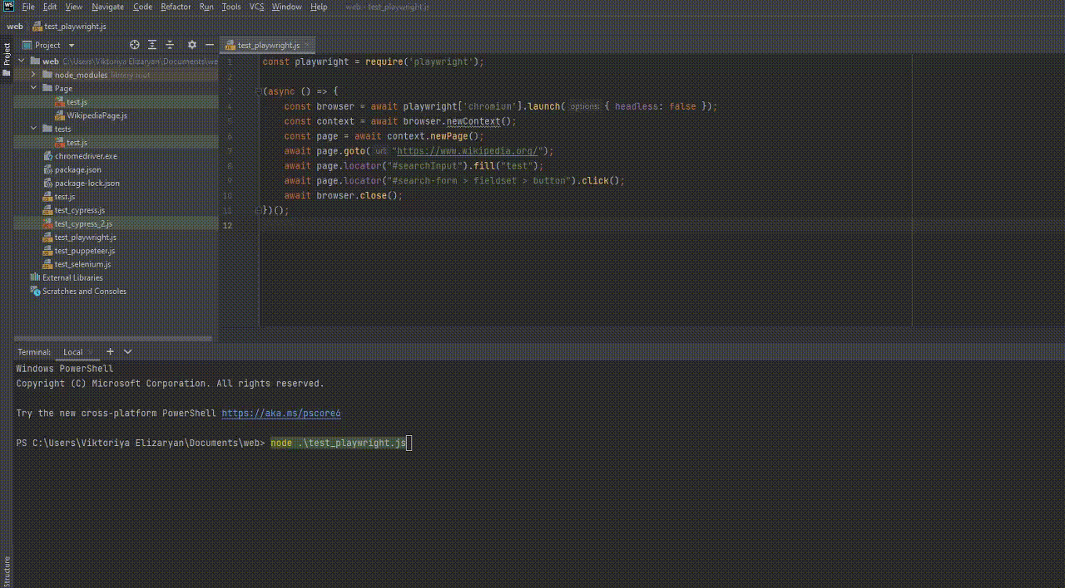
© 2022 Quantori. Custom Software Solutions
Step 3. Engines. Playwright

Slide 28
You can see that the code is actually very similar.
The only thing that makes them different is what kind of engine we take.
What's next? We can't write our code like this because:
Node.js command can run only one .js file.
If this file contains more than one test, these tests will run dependent on each other. If one test fails, the next will fail too.
We need to separate our tests. So that if one test fails, the next will go on.
© 2022 Quantori. Custom Software Solutions
Step 3. Engines.
Notes:
to solve this problem go to step 4

Slide 29
Test Runner is an application used to run tests, validate output, and provide the tools needed to diagnose and debug tests. With the Runner we can:
Divide tests into groups Suite, Сase
Add Before tests steps and After tests steps
Run tests in parallel
And much more
Popular test Runners:
Playwright Test
Jest / Jasmine
AVA
Mocha
© 2022 Quantori. Custom Software Solutions
Step 4. Autotest Runner.
Notes:
Usually each engine has its own default runner.
I think if you only start your way into Automatisation it is better to use the runner that comes with the engine by default.
Let’s do it

Slide 30
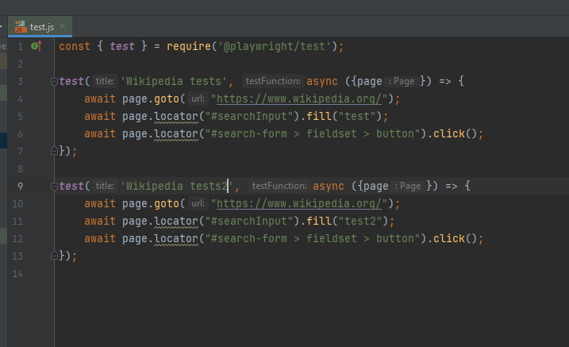
Use the playwright engine and its runner.
It is installed like this:
npm i -D @playwright/test
Run command:
npx playwright test
© 2022 Quantori. Custom Software Solutions
Step 4. Autotest Runner. Playwright
Notes:
I take playwright/test runner for playwright
Use this node command to install it
Now we can use this runner

Slide 31
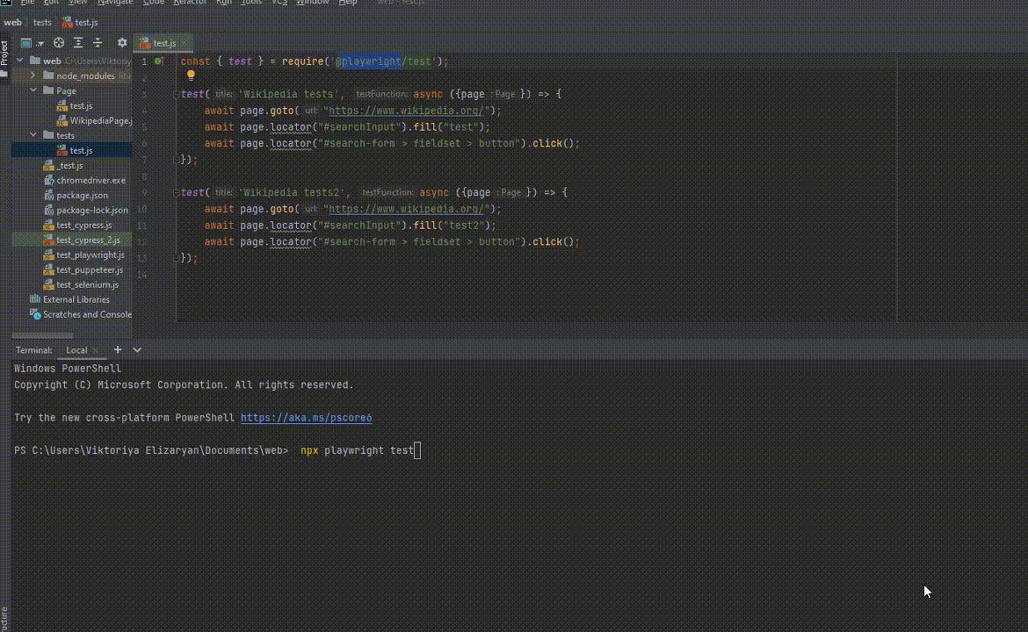
© 2022 Quantori. Custom Software Solutions
Step 4. Autotest Runner. Playwright
Notes:
We add requests to the test runner with a link and add two new tests.
now let's try to run this test
We should understand before we use node js for run our test
Now we will use playwright test runner for run
It is a “npx playwright test” command . This command run our test
This code looks good but still has some problems.
If the locator for the search button is changed we will need to update two tests.
This is not good
Page object architecture is used to solve this problem.

Slide 32
A page object is a class that serves as an interface to a page.
Pros:
Separates test code and page elements.
One page of web application equals one class of this page. Your page class is a constructor with page elements: buttons, input fields, text, link and others.
Puts all the actions into a web object page.
© 2022 Quantori. Custom Software Solutions
Step 5. Page Object architecture.
Notes:
Let's separate our code.

Slide 33
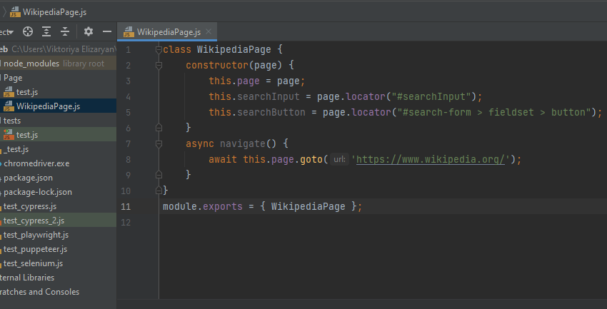
© 2022 Quantori. Custom Software Solutions
Step 5. Page Object architecture.
Page Object should duplicate the look of the page
Notes:
We created the WikipediaPage class.
This class has two elements: a search field and a click button.
And We create a method to navigate to this page.
Let's now connect this page with the test.
If some locator changes, we will change it only on this page

Slide 34
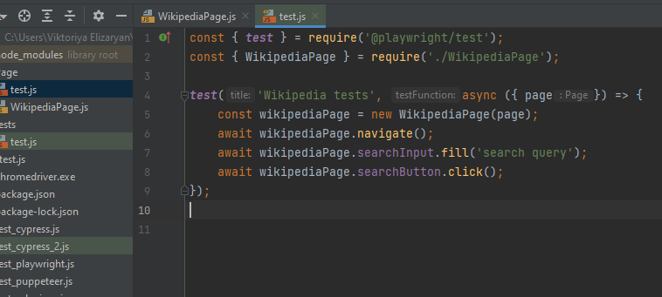
© 2022 Quantori. Custom Software Solutions
Step 5. Page Object architecture.
The code in the test imitates the user's behavior on the page.
Notes:
We came back to our test . We added a new line required to the WikipediaPage class.
Then we rewrite our test
we create a new page exemplar
Then we navigate to web page with navigate method
enter text
click on the button.
If the locator is changed, we will change it on the page class. This test will not change.
The code of the test imitates the user's behavior on the page.
The code of the page class imitates web page interface

Slide 35
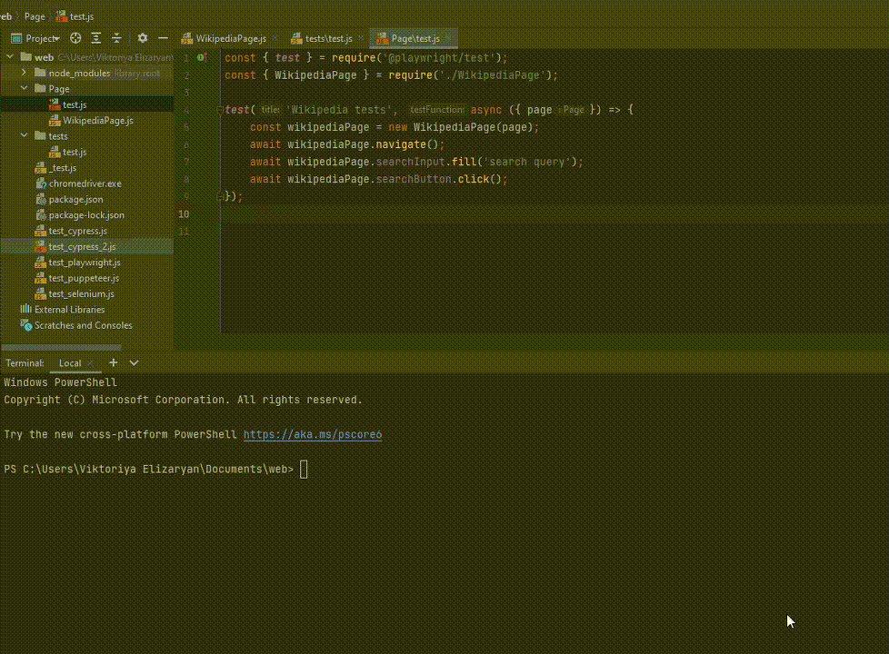
© 2022 Quantori. Custom Software Solutions
Step 5. Page Object architecture.
Notes:
Let's run our code and see that everything works well
It's all about the required steps. I'll quickly talk about others.

Slide 36
CI is the assembly, deployment and testing of an application without human intervention.
Right now your code is only on your machine. If you want to run your code independently, you must:
Push your code to remote repository
Use CI
© 2022 Quantori. Custom Software Solutions
Step 6. CI.
The most popular CI:
TeamCity
Jenkins
Azure Pipeline
GitAction
GitLab
Notes:
If we setting up continuous integration, it will take your code and run it on a independent machine

Slide 37
An autotests report is a test run report for automated tests.
It shows how many tests you was failed and passed.
Reports can be generated by the engine, runner or a third-party utility.
Your team can receive and analyze your autotest run results.
© 2022 Quantori. Custom Software Solutions
Step 7. Autotests reports.
Most popular reports:
Allure
Katalone
CucumberJS
Teamcity Reporter
Junit Reporter

Slide 38
Victoria Elizaryan
Senior Test Automation Engineer
Github link to project:
https://github.com/ViaMay/firstStep
Thank you for your attention : )
Notes:
That's all
The code will be here.
My opinion It's not really hard to become a QA Automaton,
You just need to understand these five steps and step by step go through it
I think every manual QA can do it
andI think this is the right way to evolve from a manual QA to QA Automaton

